Slide 1
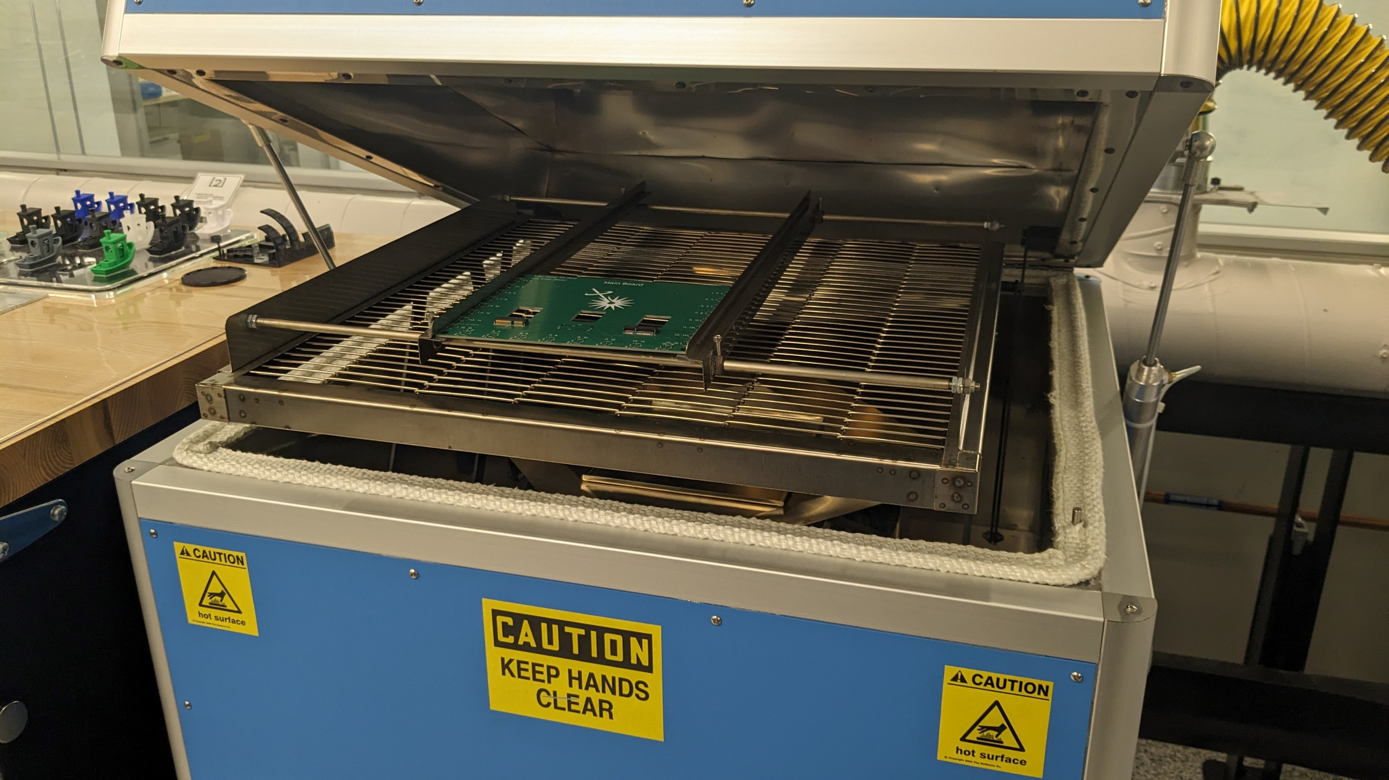
PCB & GUI Design for Photo Current Measurements
Notes:
Subtitle: for photo current meaasurements
Slide numebrs

Slide 2
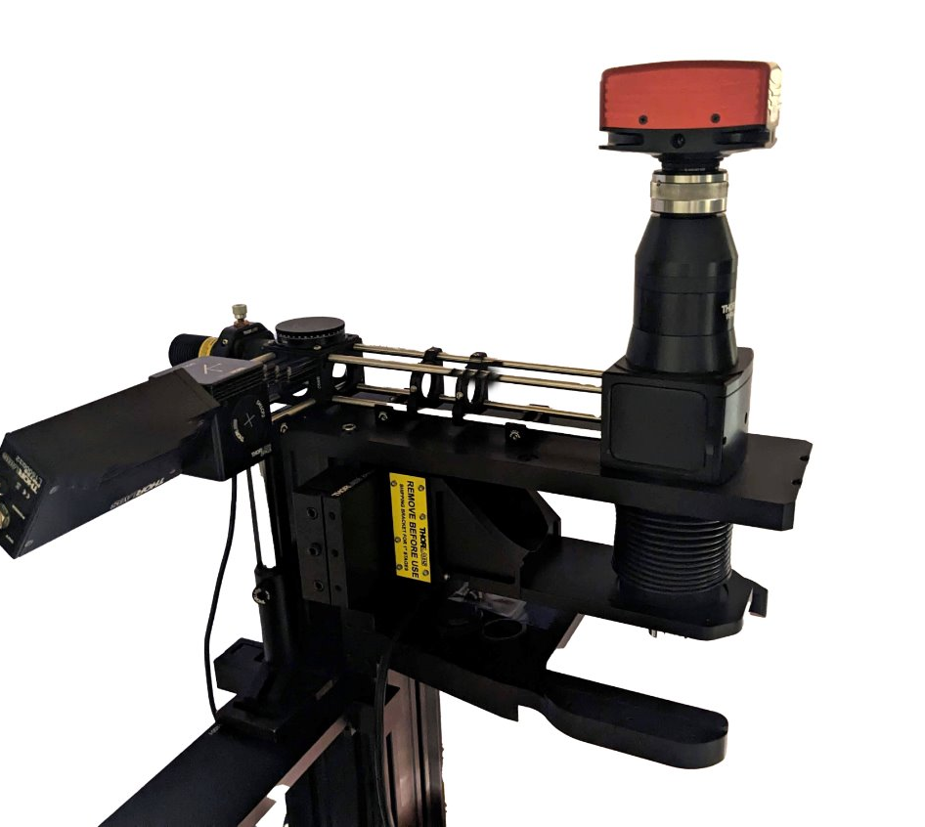
The Project

Slide 3
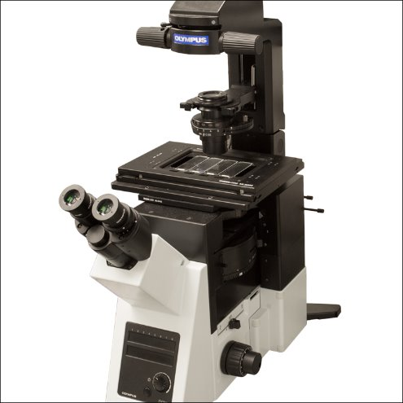
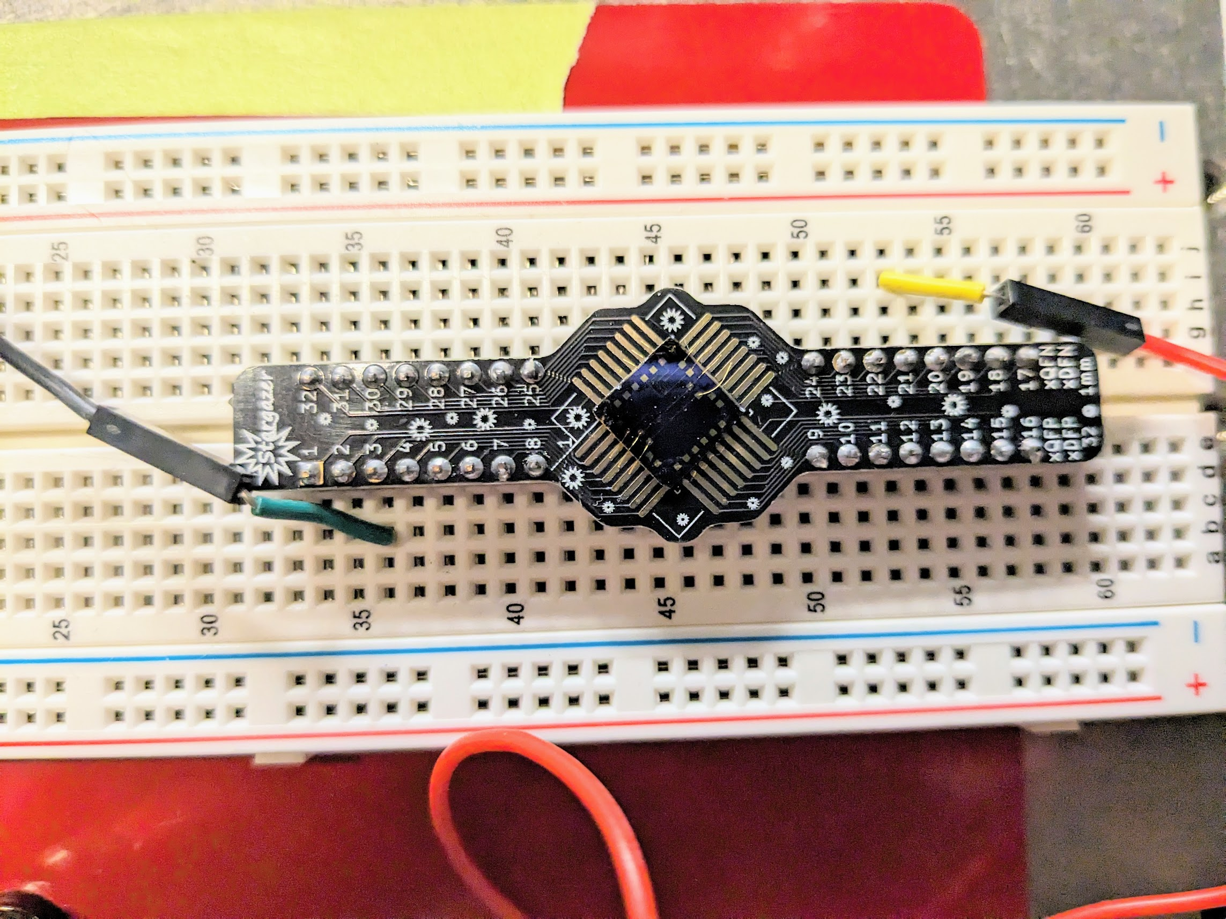


The Issue – consistent method to test samples
Specifications:
Fast
Accurate
Reliable
Notes:
Add photo of microscode

Slide 4
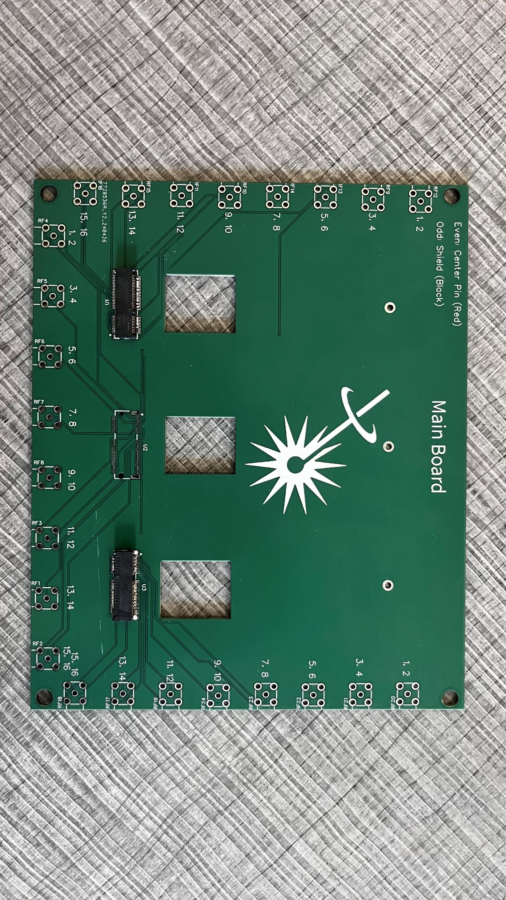
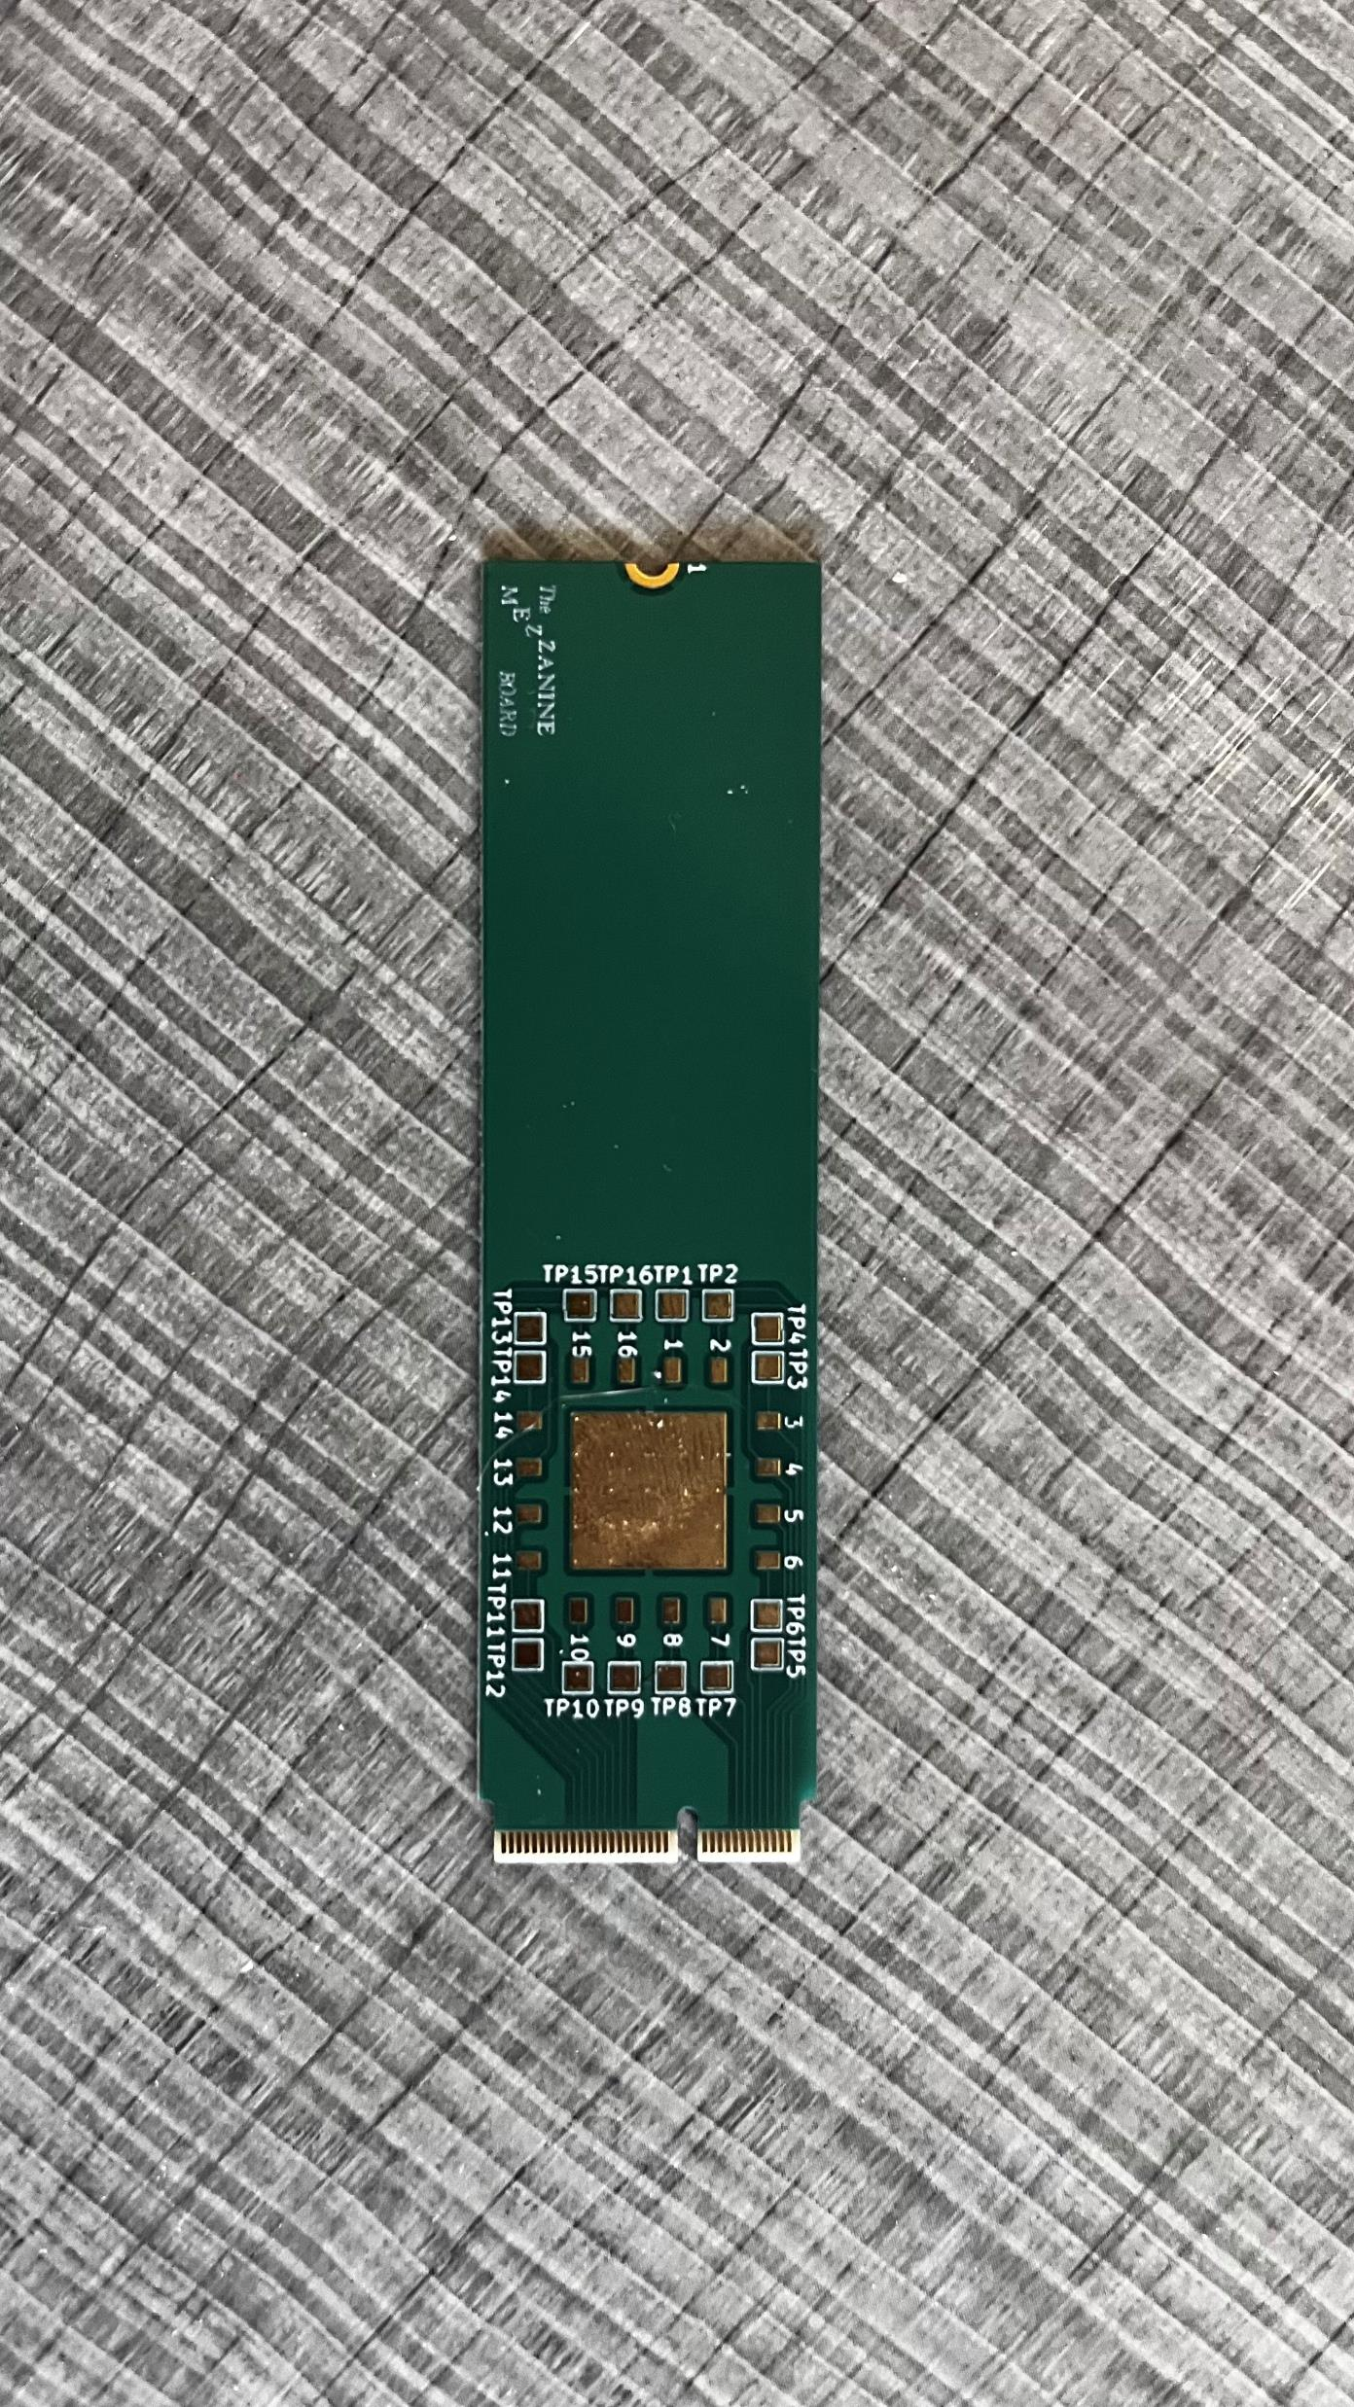
Two Board Solution

Slide 5
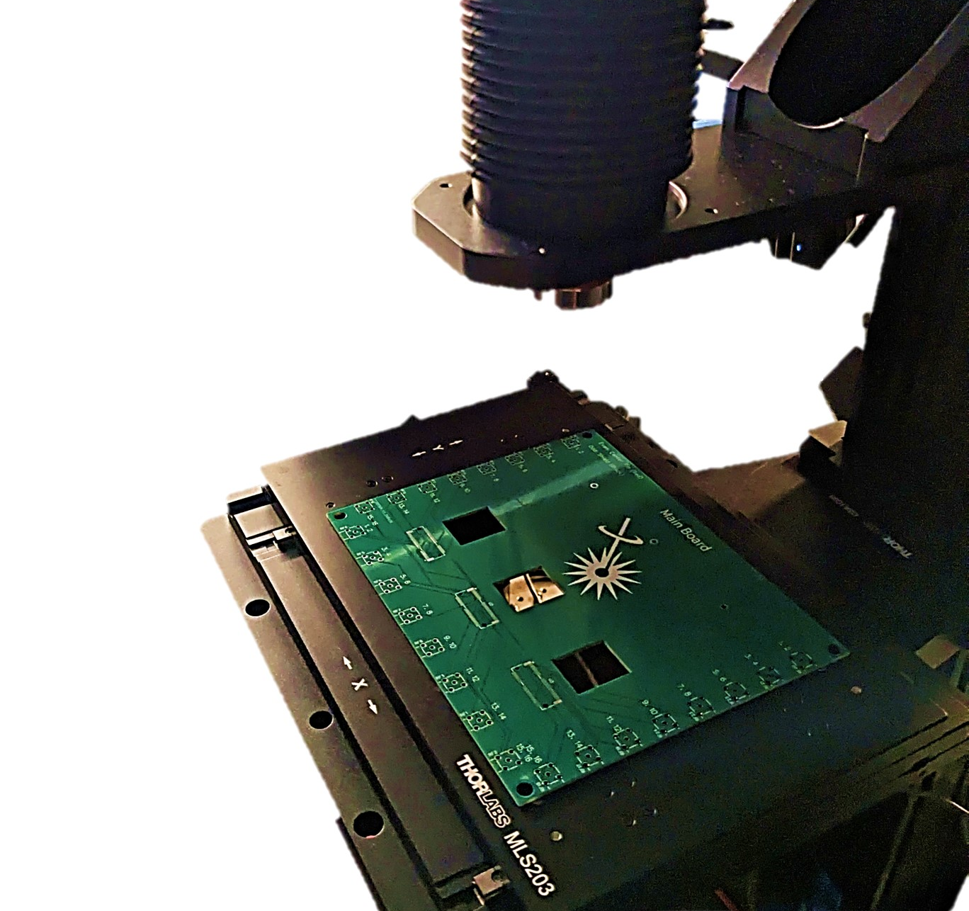
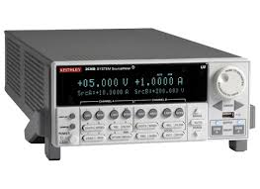


Main Board PCB
Easy way to test the samples on the mezzanine board
High fidelity connection
Easily repeatable experiments
Notes:
Visibly show a connection to the kiethley
-current meter

Slide 6
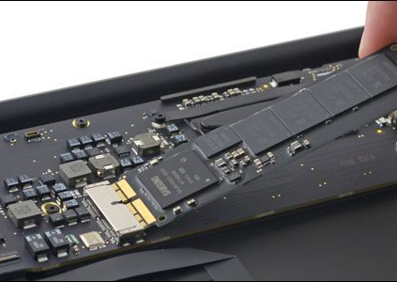
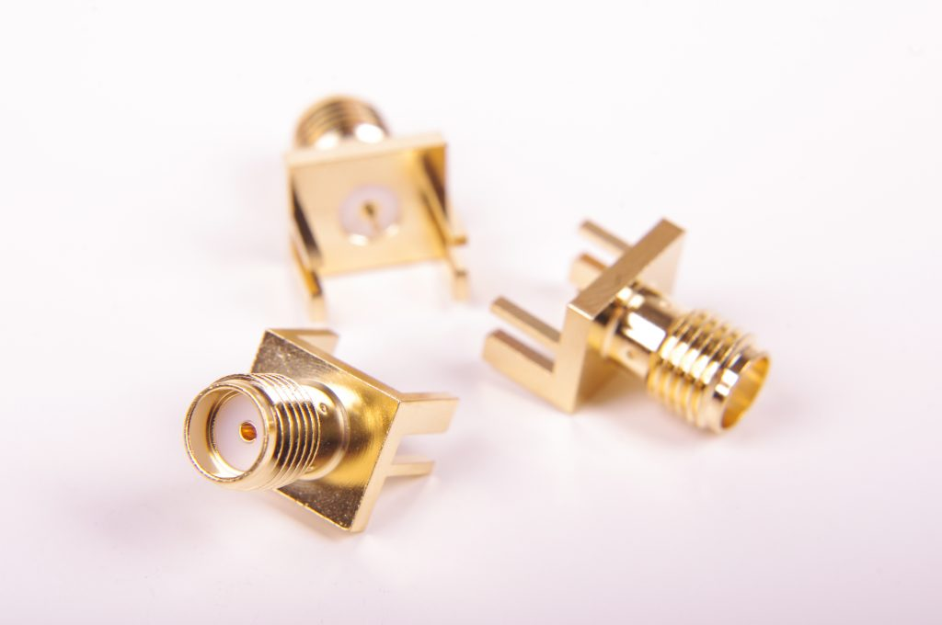
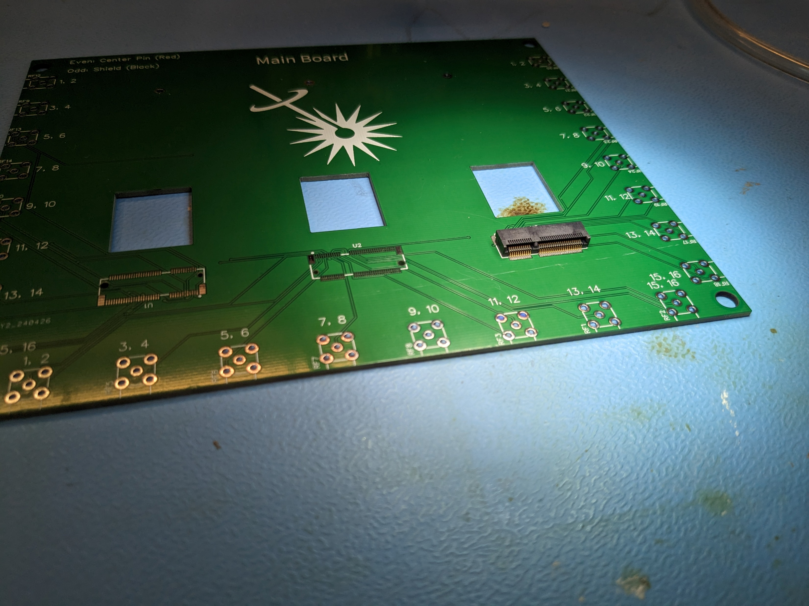
Design Features
SMA Cables for testing
M.2 Slot to connect Mezzanine Boards to Main Board
Standoffs to connects to scanning photo-current set up
Notes:
kiehtely

Slide 7
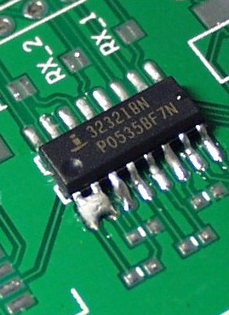
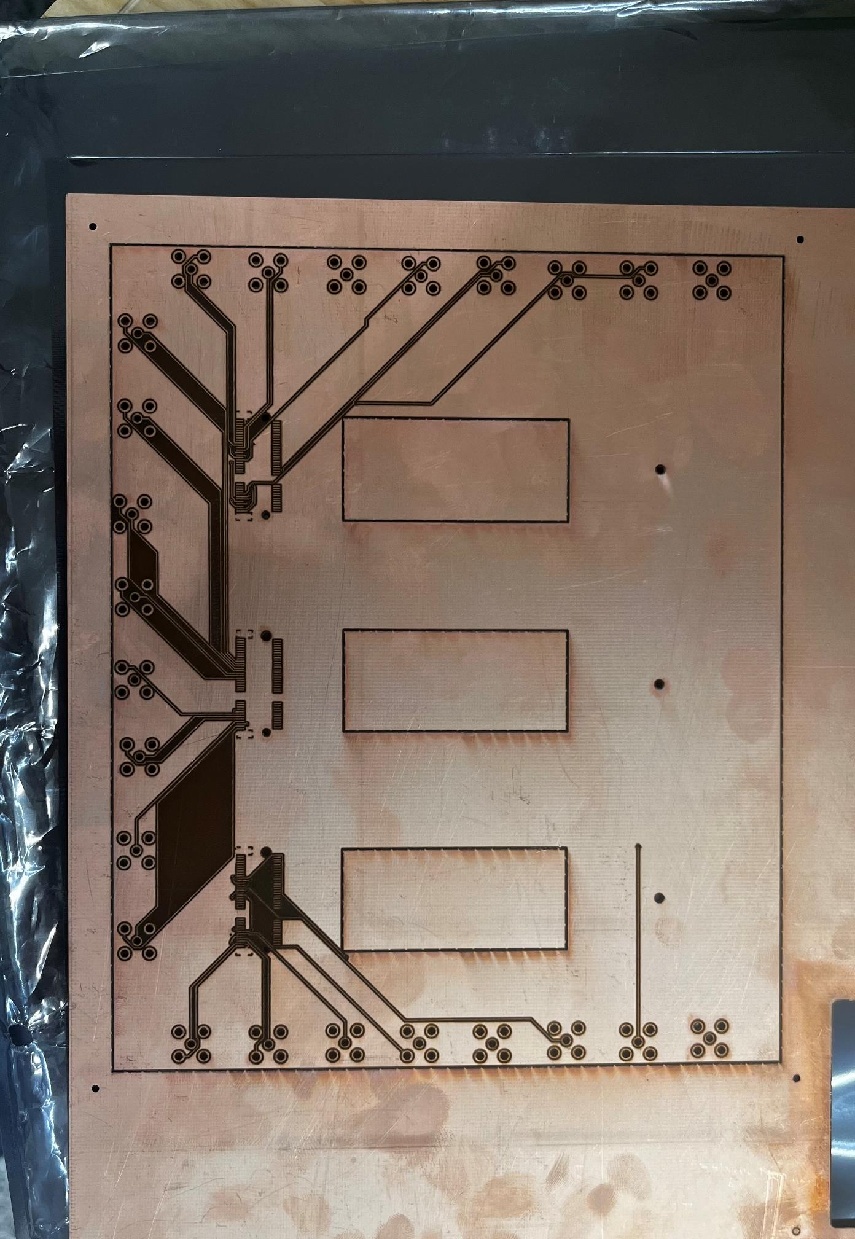
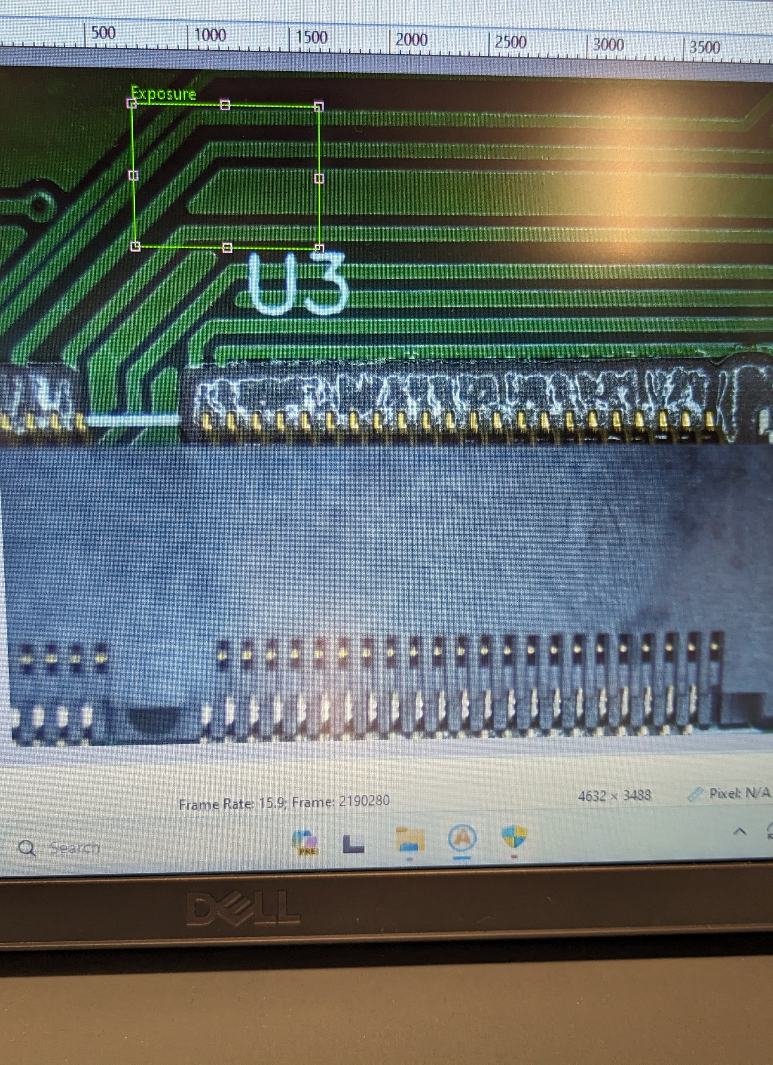
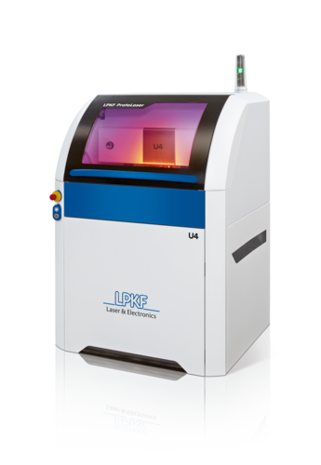
Process & Hurdles
Manufactured Test Board at the Rodgers’ Lab
Tolerance Issues
Soldered the Components Using Reflow Oven
Issue with Solder Bridging
Notes:
Rodger’s Lab board
Picture of solder bridge

Slide 8
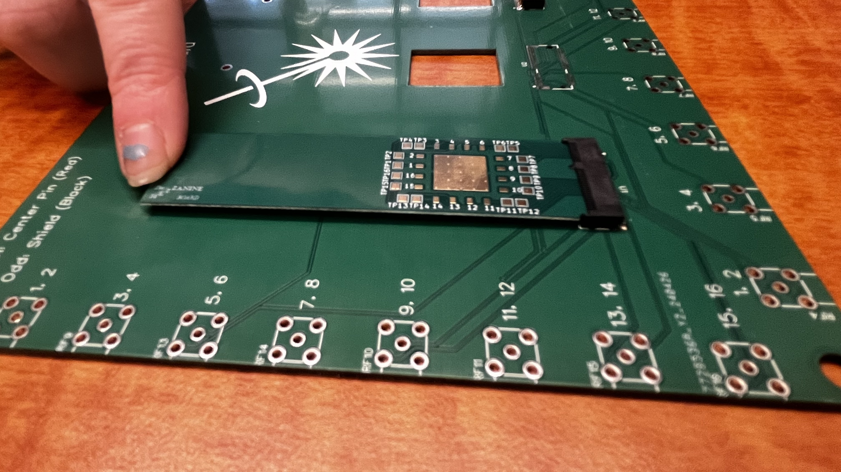
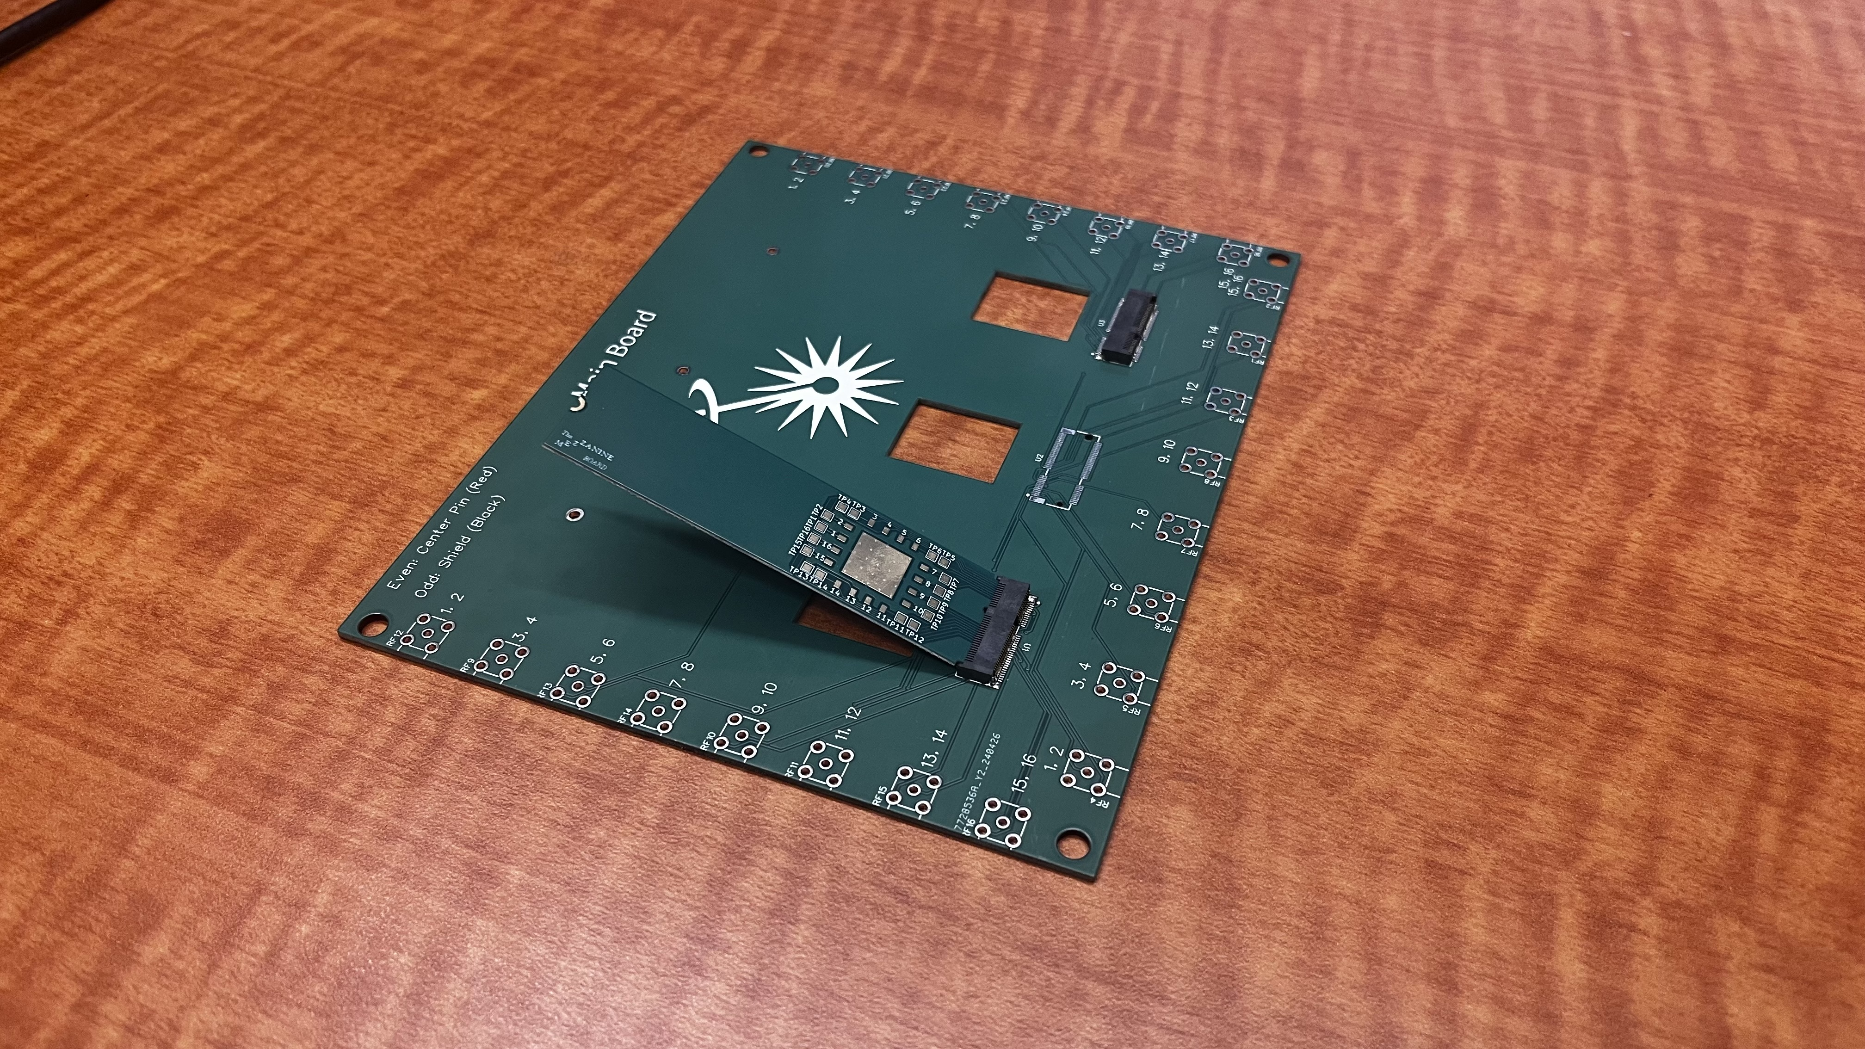
Final Result

Slide 9
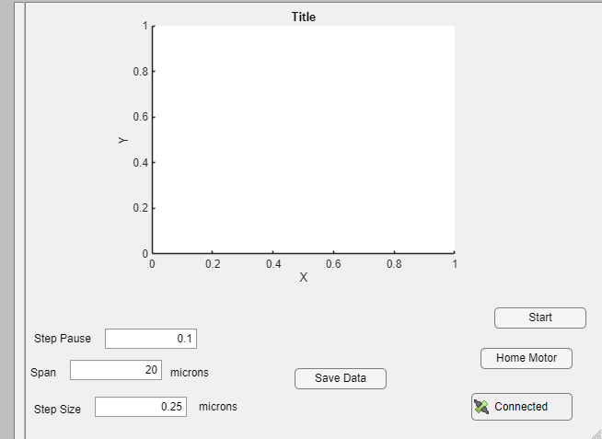
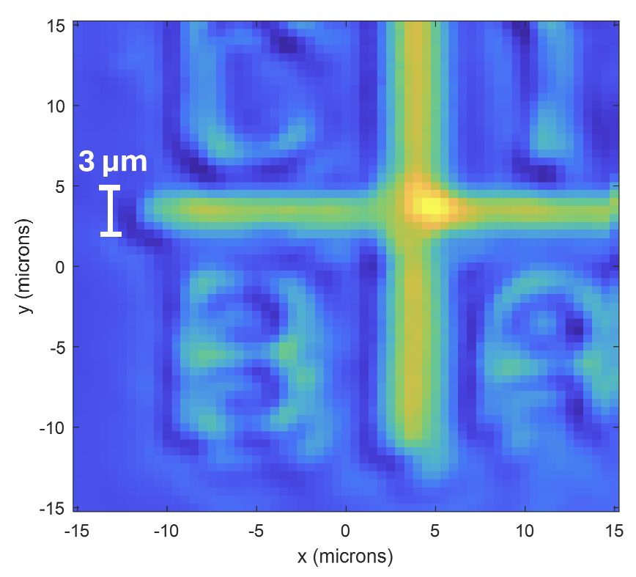
GUI Interface
Needed a simple way to adjust variables
Live data plotting
Save all the data as a mat file

Slide 10
Design
Ability to change specified values
Home the Motor
Connect to the Kiethley
Ability to save the data and the results
Notes:
Specifics can remove – edit to movement instructions (more broad)

Slide 11
Take Aways
Hands-on Lab Experience
PCB Manufacturing
Reflow Oven
Designing within specific tolerances
Learning Mat Lab
How to design a GUI

Slide 12
Summer Plans
Headed back to Oregon!
Working as a mentor for MIT Futuremakers
I plan to work on a few projects
Smash Ulitimate AI
- Modded Game Boy Advance

